Slide 1
CS3210 Tut 3
Memory Consistency & Cuda Programming
Slides inspired from Sriram
+ extra tidbits

Slide 2
Admin Stuff
Feedback Survey on quiz % weightage on overall grade, closing tonight!
Check Canvas Announcement for more details
Quiz 2 will be releasing Wednesday, 6 pm.
Finished marking Lab 2, generally not much problems

Slide 3
Some heads up
Next week is also a tutorial session!
Lab 4 is Week 10
Assignment 2 will be releasing (...soon!)
Spend the time to go through Lab 3 yourself, ask me if you need help!
All GPU nodes should be up and running now (unlike last week)
Let us know if you encounter any issues with the GPU compute cluster (and we'll make more complaints to SoC ☺️).

Slide 4
Recap: Cache Coherence & Consistency

Slide 5
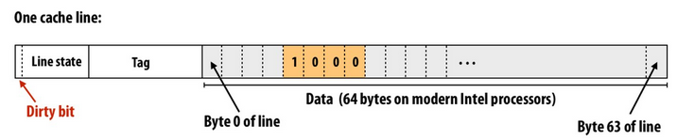
Cache Write Policy
2 TYPES
Write-through: Writes to memory locations are immediately committed to main memory
Write-back: Write operations are done in cache, and committed to main memory upon expiry/replacement.
Dirty bit is in cache only, indicates cache line has to be written back to memory.
Dirty bit will not be set for cache lines that are read-only (i.e. no writes to them).

Slide 6
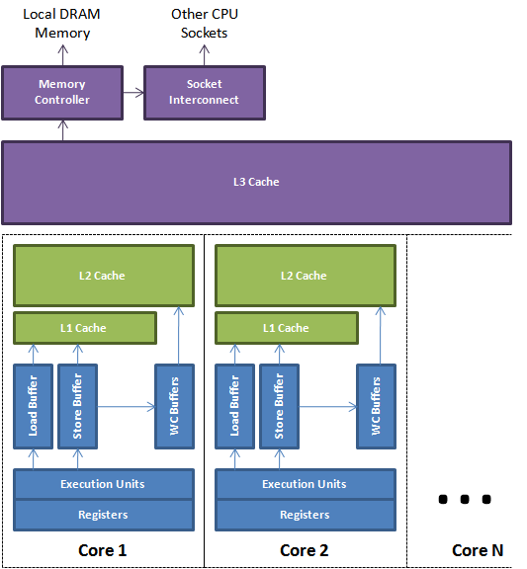
Coherence vs Consistency
2 DIFFERENT ISSUES!
Coherence: how cores agree on what is at a single memory location.
Consistency: how cores agree on the order of memory operations to different memory locations

Slide 7
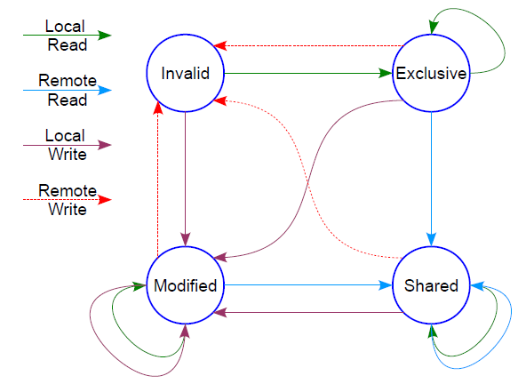
Coherence
Coherence
Core 1
Core 2
Core 3
X = 3
read X → r1
X = r + 1
Usually: hardware has a cache coherence protocol.
Guarantees:
Write Propagation: changes in one cache are propagated to the rest, eventually
Tx Serialization: everyone sees changes in the same order
read X
How to guarantee that Core 3 reads x = 4?
t
We always assume coherence is preserved! Insanity, otherwise.

Slide 8
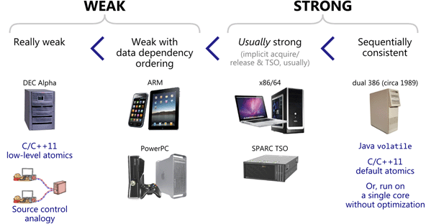
Consistency
Consistency
Core 1
Core 2
X = 3
print X
Y = 5
print Y
t
What guarantees does hardware give us about the result of these assembly instructions?
Each ISA (architecture) specifies exactly what we can expect!

Slide 9
Why all these memory tricks?
Balance between speedup from caching while staying correct.
Best optimization developers understand & exploit this to write fast programs.

Slide 10


Imagine this scenario
Drive 16 hours to work
Work for 5 minutes
Drive 16 hours back!!

Slide 11
Same case here!!
Imagine x += 1
r1 ← load x
add r, r, 1
r1 → store x
CPU instruction takes 1 cycle, say 0.5 ns on 2 GHz CPU
Memory access w/o cache takes 100 ns (200x slower)
Emphasized previously, IO operations like reading/writing are the main bottleneck in many programs!

Slide 12
Memory Models in CS3210
Property | Sequential Consistency (SC) | Total Store Ordering (TSO) | Processor Consistency (PC) | Partial Store Ordering (PSO)
Respects data dependencies within the same core (e.g. don't reorder x = 5, read x) | Yes
Preserves R → R and R → W order | Yes
Preserves W → R
Preserves W → W
All processors must be able to see the same value before a read completes (Write Atomicity)

Slide 13
Memory Models in CS3210
Property | Sequential Consistency (SC) | Total Store Ordering (TSO) | Processor Consistency (PC) | Partial Store Ordering (PSO)
Respects data dependencies within the same core (e.g. don't reorder x = 5, read x) | Yes
Preserves R → R and R → W order | Yes
Preserves W → R | Yes | No | No | No
Preserves W → W | Yes | Yes | Yes | No
All processors must be able to see the same value before a read completes (Write Atomicity) | Yes | Yes | No | Yes

Slide 14
Focus: Processor Consistency (PC)
Processor Consistency Relaxes W → R and:
A read can return the value of any write before the write is made visible to other processors
Core 1
Core 2
Core 3
X = 5
Core is doing something else…
Core is doing something else…
Assume that the instructions execute in this order
prints 5
print X
Y = 5
while(Y==0);
print X
t
can print 0

Slide 15
Focus: Processor Consistency (PC)
Processor Consistency Relaxes W → R and:
A read can return the value of any write before the write is made visible to other processors
Core 1
Core 2
Core 3
X = 5
Core is doing something else…
Core is doing something else…
Assume that the instructions execute in this order
prints 5
print X
X = 7
while(X!=7);
print X
t
Always print 7. Why?

Slide 16
Agenda
Tutorial: Memory COnsistency
Tutorial: CUDA thought process
(Maybe) go through sum.cu from Lab 3

Slide 17
Question 1

Slide 18
Question 1a: Sequential Consistency
P1
P2
P3
X = 1
while(Y==0);
Z = 2
Y = 1
while(Z==0);
X = 3
while(T==0);
T = X
while(T==0);
print A
A = X
print B
B = X
Given sequential consistency, what values are guaranteed to be the same at the end of instructions?

Slide 19
Question 1a: Sequential Consistency
P1
P2
P3
X = 1
while(Y==0);
Z = 2
Y = 1
while(Z==0);
X = 3
while(T==0);
T = X
while(T==0);
print A
A = X
print B
B = X
We can draw out the write → read dependencies (thicker lines = while)
Y = 1 must be true, no other writes to Y
Z = 2 must be true, no other writes to Z
A, B, T, X are unknowns.

Slide 20
Question 1a: Sequential Consistency
P1
P2
P3
X = 1
while(Y==0);
Z = 2
Y = 1
while(Z==0);
X = 3
while(T==0);
T = X
while(T==0);
print A
A = X
print B
B = X
What values can A, B, T, X have after all operations are completed?
Notes:
X=1 while(Y==0); Z=2
Y=1 while(Z==0); X=3
T=X
A=X
B=X

Slide 21
Question 1a: Sequential Consistency
P1
P2
P3
X = 1
X = 3
X = 1 already done
T = X
A = X
B = X
What values can A, B, T, X have after all operations have completed?
The only relevant interleaving is (T,A,B = X) and (X = 3)
5 possible positions for X = 3 (note: X=3 can run before X=1)
X = 1 ⇒ {T, A, B} = 1 || {X, T, A, B} = 3 || X = 3, T = 1, {A, B} = 3 X = 3, {T, A} = 1, B = 3 || X = 3, {T, A, B} = 1

Slide 22
Question 1a: Sequential Consistency
P1
P2
P3
X = 1
while(Y==0);
Z = 2
Y = 1
while(Z==0);
X = 3
while(T==0);
T = X
while(T==0);
print A
A = X
print B
B = X
How can we print A, B as different values?
Notes:
X=1 while(Y==0); Z=2
Y=1 while(Z==0); X=3
T=X
A=X
B=X

Slide 23
Question 1b: Sequential Consistency
P1
P2
P3
X = 1
while(Y==0);
Z = 2
Y = 1
while(Z==0);
X = 3
while(T==0);
T = X
while(T==0);
print A
A = X
print B
B = X
How can we print A, B as different values?
X = 1 ⇒ … ⇒ A = X ⇒ print A ⇒ X = 3 ⇒ B = X ⇒ print B
Notes:
X=1 while(Y==0); Z=2
Y=1 while(Z==0); X=3
T=X
A=X
B=X

Slide 24
Question 1c: Sequential Consistency
P1
P2
P3
X = 1
while(Y==0);
Z = 2
Y = 1
while(Z==0);
X = 3
while(T==0);
T = X
while(T==0);
print A
A = X
print B
B = X
How can we change this to print the same value for print A & print B?
Aside from changing or removing X = 1/X = 3 lines! Only requires swapping some lines.
Notes:
X=1 while(Y==0); Z=2
Y=1 while(Z==0); X=3
T=X
A=X
B=X

Slide 25
Question 1c: Sequential Consistency
P1
P2
P3
X = 1
while(Y==0);
X = 3
Y = 1
while(Z==0);
Z = 2
while(T==0);
T = X
while(T==0);
print A
A = X
print B
B = X
1. Swap Z = 2, X = 3 (X = 3 must happen before T, A, B sets to X)
Notes:
X=1 while(Y==0); Z=2
Y=1 while(Z==0); X=3
T=X
A=X
B=X

Slide 26
Question 1c: Sequential Consistency
P1
P2
P3
X = 1
while(Y==0);
X = 3
Y = 1
while(Z==0);
Z = 2
while(T==0);
A = X
while(T==0);
print A
B = X
print B
T = X
1. Swap Z = 2, X = 3 (X = 3 must happen before T, A, B sets to X)
2. Put T = X after setting A, B (set A, B first then release the prints)
Will print either A,B = 1 or A,B = 3!
Notes:
X=1 while(Y==0); Z=2
Y=1 while(Z==0); X=3
T=X
A=X
B=X

Slide 27
Question 1d: Fails under TSO/PC/PSO?
P1
P2
P3
X = 1
while(Y==0);
X = 3
Y = 1
while(Z==0);
Z = 2
while(T==0);
A = X
while(T==0);
print A
B = X
print B
T = X
Will we still print the same A, B under TSO/PC/PSO?
Notes:
X=1 while(Y==0); Z=2
Y=1 while(Z==0); X=3
T=X
A=X
B=X

Slide 28
Question 1d: Fails under TSO/PC/PSO?
P1
P2
P3
X = 1
while(Y==0);
X = 3
Y = 1
while(Z==0);
Z = 2
while(T==0);
A = X
while(T==0);
print A
B = X
print B
T = X
Will we still print the same A, B under TSO/PC/PSO? TSO: Relaxed W → R on same processor if no data dependencies.
Still OK: there are no W → R instructions that can be reordered! Note: Control/cmp instructions don't count here
Notes:
X=1 while(Y==0); Z=2
Y=1 while(Z==0); X=3
T=X
A=X
B=X

Slide 29
Question 1d: Fails under TSO/PC/PSO?
P1
P2
P3
X = 1
while(Y==0);
X = 3
Y = 1
while(Z==0);
Z = 2
while(T==0);
A = X
while(T==0);
print A
B = X
print B
T = X
Will we still print the same A, B under TSO/PC/PSO? PC: Relaxed W → R on same processor, processors see writes at different times
Still OK: there are no W → R instructions that can be reordered! Note: Control/cmp instructions don't count here
Notes:
X=1 while(Y==0); Z=2
Y=1 while(Z==0); X=3
T=X
A=X
B=X

Slide 30
Question 1d: Fails under TSO/PC/PSO?
P1
P2
P3
X = 1
while(Y==0);
X = 3
Y = 1
while(Z==0);
Z = 2
while(T==0);
A = X
while(T==0);
print A
B = X
print B
T = X
Will we still print the same A, B under TSO/PC/PSO? PSO: Relaxed W→R, W→W on same processor if no dependencies
Fails! We can reconstruct our original failing code by swapping the write orders.
Notes:
X=1 while(Y==0); Z=2
Y=1 while(Z==0); X=3
T=X
A=X
B=X

Slide 31
Question 2

Slide 32
Question 2: Relaxed Consistency
P1
P2
P3
X = 5
while(X==0);
while(Y==0);
Y = 2
Y = 6
Z = 5
print Y
print Z
print X
We observed prints of X = 5, Y = 2, Z = 0
Under which relaxed consistency models is this valid?
Notes:
X=5 while(X==0); while(Y==0);
Y=2 Y=6 Z=5
print Y print Z print X

Slide 33
Question 2: Relaxed Consistency
P1
P2
P3
X = 5
while(X==0);
while(Y==0);
Y = 2
Y = 6
Z = 5
print Y
print Z
print X
We observed prints of X = 5, Y = 2, Z = 0
Under which relaxed consistency models is this valid?
Tactic: Try from most strict model first: Sequential Consistency
If possible under SC, then possible under other models too!
Notes:
X=5 while(X==0); while(Y==0);
Y=2 Y=6 Z=5
print Y print Z print X

Slide 34
Question 2: Relaxed Consistency
P1
P2
P3
X = 5
while(X==0);
while(Y==0);
Y = 2
Y = 6
Z = 5
print Y
print Z
print X
We observed prints of X = 5, Y = 2, Z = 0
Under which relaxed consistency models is this valid?
Tactic: Try from most strict model first: Sequential Consistency
If possible under SC, then possible under other models too!
Possible under SC: P1 runs entirely, then P2, then P3
Notes:
X=5 while(X==0); while(Y==0);
Y=2 Y=6 Z=5
print Y print Z print X

Slide 35
Question 2: Relaxed Consistency
P1
P2
P3
X = 5
while(X==0);
while(Y==0);
Y = 2
Y = 6
Z = 5
print Y
print Z
print X
We observed prints of X = 0, Y = 2, Z = 5
Under which relaxed consistency models is this valid?
Notes:
X=5 while(X==0); while(Y==0);
Y=2 Y=6 Z=5
print Y print Z print X

Slide 36
Question 2: Relaxed Consistency
P1
P2
P3
X = 5
while(X==0);
while(Y==0);
Y = 2
Y = 6
Z = 5
print Y
print Z
print X
We observed prints of X = 0, Y = 2, Z = 5
Under which relaxed consistency models is this valid?
Idea: try to find invariants that must be broken.
print X = 0 ⇒ while(Y == 0) triggered ⇒ Y != 0
Not possible under SC! Y != 0 ⇒ X != 0 Also not possible under TSO! W → R swapping does not explain this.
Notes:
X=5 while(X==0); while(Y==0);
Y=2 Y=6 Z=5
print Y print Z print X

Slide 37
Question 2: Relaxed Consistency
P1
P2
P3
X = 5
while(X==0);
while(Y==0);
Y = 2
Y = 6
Z = 5
print Y
print Z
print X
We observed prints of X = 0, Y = 2, Z = 5
What about PC?
Possible! X = 5 reaches P2 but not P3 yet. (no write atomicity)
What about PSO?
Possible! Y = 2 reordered before X = 5
Notes:
X=5 while(X==0); while(Y==0);
Y=2 Y=6 Z=5
print Y print Z print X

Slide 38
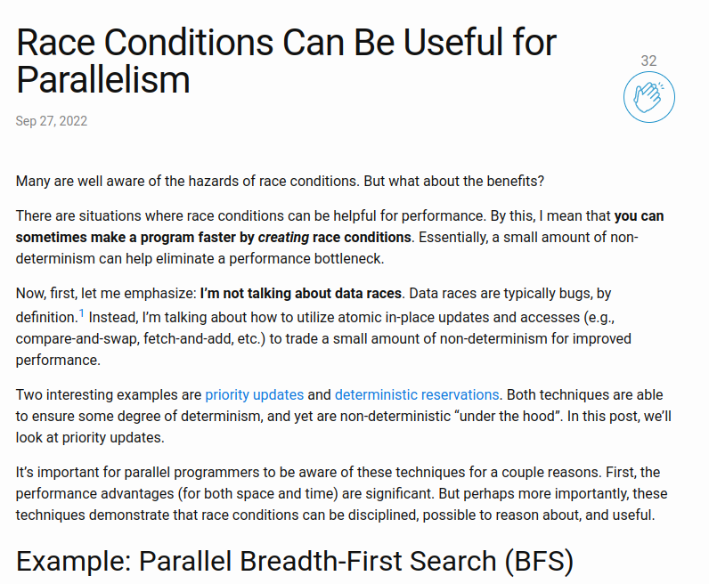
Why does this matter?
Most other courses (e.g. CS2106) assume sequential consistency for multithreaded programs.
In reality, most architectures (ARM, X86/64 included) do not implement sequential consistency.
If you don't know about consistency models, low-level code might have issues/be slow and you don't know why.
If you do know about consistency models, your code can be super-fast and correct.

Slide 39
Question 3: Matrix-Vector Mul on GPU (PYP)

Slide 40
Question 3: Matrix-Vector Mul on GPU (PYP)
Is the CUDA memory model shared/distributed/both?

Slide 41
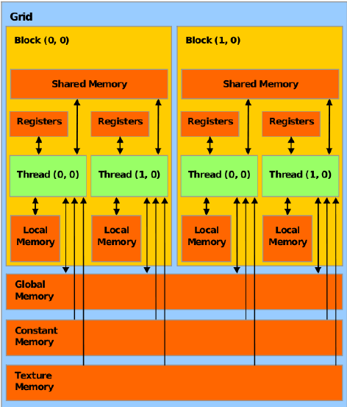
Question 3: Matrix-Vector Mul on GPU (PYP)
Is the CUDA memory model shared/distributed/both?
Both: Distributed + Shared
"Shared memory" is actually private to each block and must be explicitly copied.
Also: host vs device memory

Slide 42
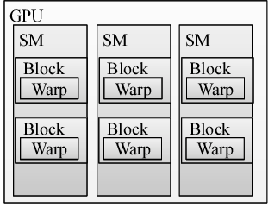
As a recap…
One streaming multiprocessor on the GPU can have multiple blocks
Each block is executed as warps with 32 threads each
Warps execute in lockstep (mostly)

Slide 43
Question 3: Matrix-Vector Mul on GPU (PYP)
A kernel uses 64 registers
Each block uses 512 threads
GPU device has 1024x64 registers total (Assuming CC 6.x)
GPU has only 1 SM
How many resident blocks / warps on the SM?

Slide 44
Question 3: Matrix-Vector Mul on GPU (PYP)
A kernel uses 64 registers
Each block uses 512 threads
GPU device has 1024x64 registers total (Assuming CC 6.x)
GPU has only 1 SM
How many resident blocks / warps on the SM?
# registers required per block:
(512 threads) x (64 registers for each thread to run)
Total number of resident blocks:
(1024x64) total no. of registers in SM / (512x64) registers per block
2 blocks
2 blocks x (512 / 32 warps per block) = 32 warps

Slide 45
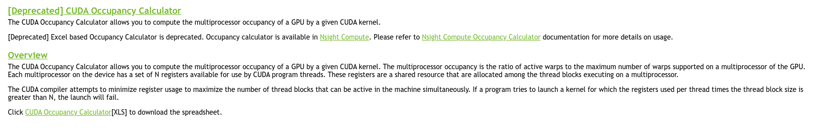
Real World: CUDA Occupancy Calculator
Nvidia used to provide an excel sheet to calculate occupancy, but it's deprecated in favour of their Nsight Compute (ncu) program.
Online webpage to calculate occupancy: https://xmartlabs.github.io/cuda-calculator/
Compute Capability 6.x
64 registers per thread
512 threads per block

Slide 46
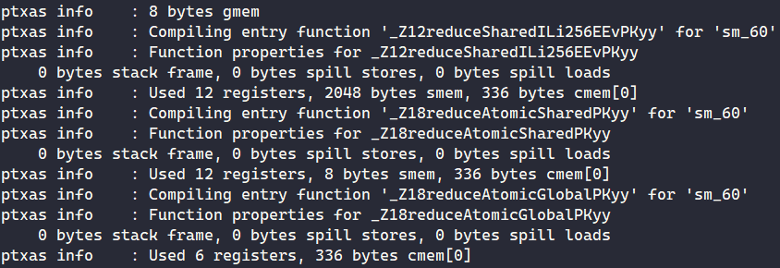
But how do we know about register/shared mem usage?
srun -G a100mig /usr/local/cuda/bin/nvcc --ptxas-options=-v --std=c++17 -arch sm_60 sum_ans.cu
We can see
#register user per kernel
shared memory (smem) use per kernel
constant memory (cmem) use per kernel
Now we can put that info into the Occupancy Calculator!
Just take note Occupancy is not the only thing that matters for performance (more on that later).

Slide 47
Question 3: Matrix-Vector Mul on GPU (PYP)
Implement matrix-vector multiplication in CUDA.
There are many ways to do this!

Slide 48
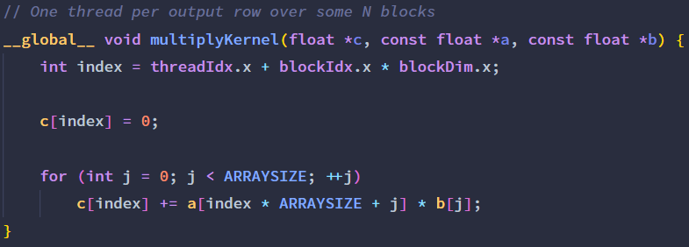
Question 3: Matrix-Vector Mul on GPU (PYP)
Most simple version
Each CUDA thread handles 1 cell of the output matrix c
All threads read from global memory (matrix a, vector b) and write back to global memory (vector c)
srun -G titanrtx ./simple
Any suggestions for improvement?

Slide 49
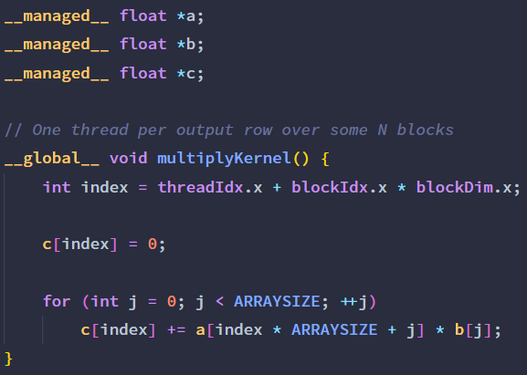
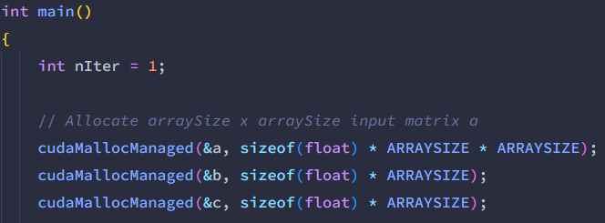
Question 3: Matrix-Vector Mul on GPU (PYP)
Try to use managed memory and let CUDA figure out how/when to copy the matrices?
srun -G titanrtx /usr/local/cuda/bin/nvprof ./simple
srun -G titanrtx /usr/local/cuda/bin/nvprof ./managed

Slide 50
Question 3: Matrix-Vector Mul on GPU (PYP)
Try to use managed memory and let CUDA figure out how/when to copy the matrices?
srun -G titanrtx /usr/local/cuda/bin/nvprof ./simple
srun -G titanrtx /usr/local/cuda/bin/nvprof ./managed
Only sometimes letting CUDA bring out the pages of memory into GPU on-demand can be better! CUDA may overlap memory operations with computation.
(and you write less code too, useful for finals ;) )

Slide 51
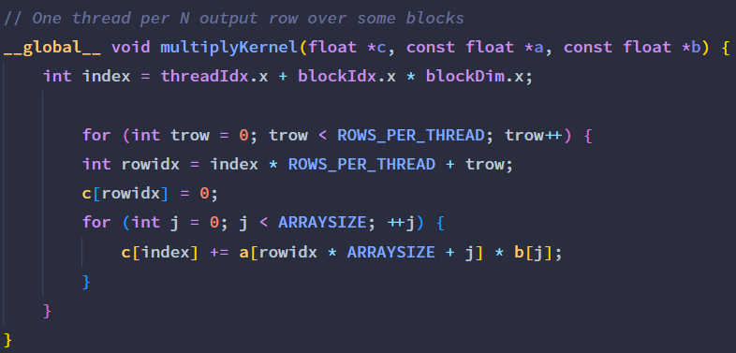
Question 3: Matrix-Vector Mul on GPU (PYP)
How about assigning multiple output rows/cells to one thread?
srun -G titanrtx /usr/local/cuda/bin/nvprof ./multirow

Slide 52
Question 3: Matrix-Vector Mul on GPU (PYP)
How about assigning multiple output rows/cells to one thread?
srun -G titanrtx /usr/local/cuda/bin/nvprof ./multirow
Bad idea: utilizes fewer threads, complicates things.

Slide 53
What is the point I'm trying to make?
Sometimes simple is better (this is especially so for GPGPU computation!)
Must always experiment, profile and test!

Slide 54
Other notes about CUDA development

Slide 55
Option to not use sbatch gpu_job.sh
Creates too many log files, need to view them separately @.@
Tip: Use srun and chain commands so it prints to console instead of creating log files.
Template command: srun -G a100mig bash -c "/usr/local/cuda/bin/nvcc -arch native hello.cu -o hello; ./hello"
/usr/local/cuda/bin/nvcc -arch native hello.cu -o hello;
Compiles hello.cu into hello
./hello
Runs the program afterwards
Can update a100mig to any of the gpu names or just "-G 1" to select whatever that is available.

Slide 56
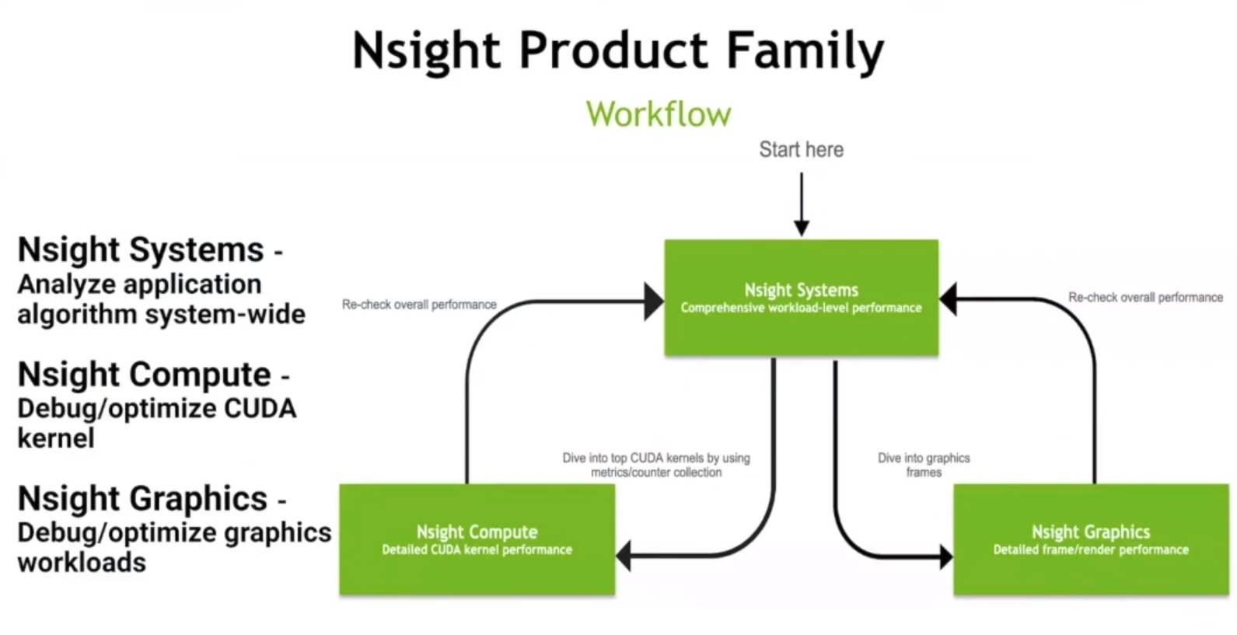
Details: Nvidia profilers
Simple way to profile CUDA programs despite being deprecated.
Does not work on CC 8.0 and above (i.e. cannot use on a100 or a100mig!)
Newer profilers: ncu & nsys
Working with SoC to enable access to these profilers in the nodes
But usually nvprof is sufficient to identify bottlenecks.

Slide 57
Demo: nvprof
Simple way to profile CUDA programs despite being deprecated.
Does not work on CC 8.0 and above (i.e. cannot use on a100 or a100mig!)
srun -G titanrtx bash -c "/usr/local/cuda/bin/nvcc -arch native atomic.cu -o atomic; /usr/local/cuda/bin/nvprof ./atomic"
What does it show? Similarly to regular C++ programs, atomic addition runs slower than regular additions (though regular additions cause race conditions).

Slide 58
Demo: nvprof
vim copyalot.cu
srun -G 1 bash -c "/usr/local/cuda/bin/nvcc -arch native copyalot.cu -o copyalot; /usr/local/cuda/bin/nvprof ./copyalot"

Slide 59
Demo: nvprof
vim copyalot.cu
srun -G 1 bash -c "/usr/local/cuda/bin/nvcc -arch native copyalot.cu -o copyalot; /usr/local/cuda/bin/nvprof ./copyalot"
Can see time taken for memcpy and GPU computation!

Slide 60
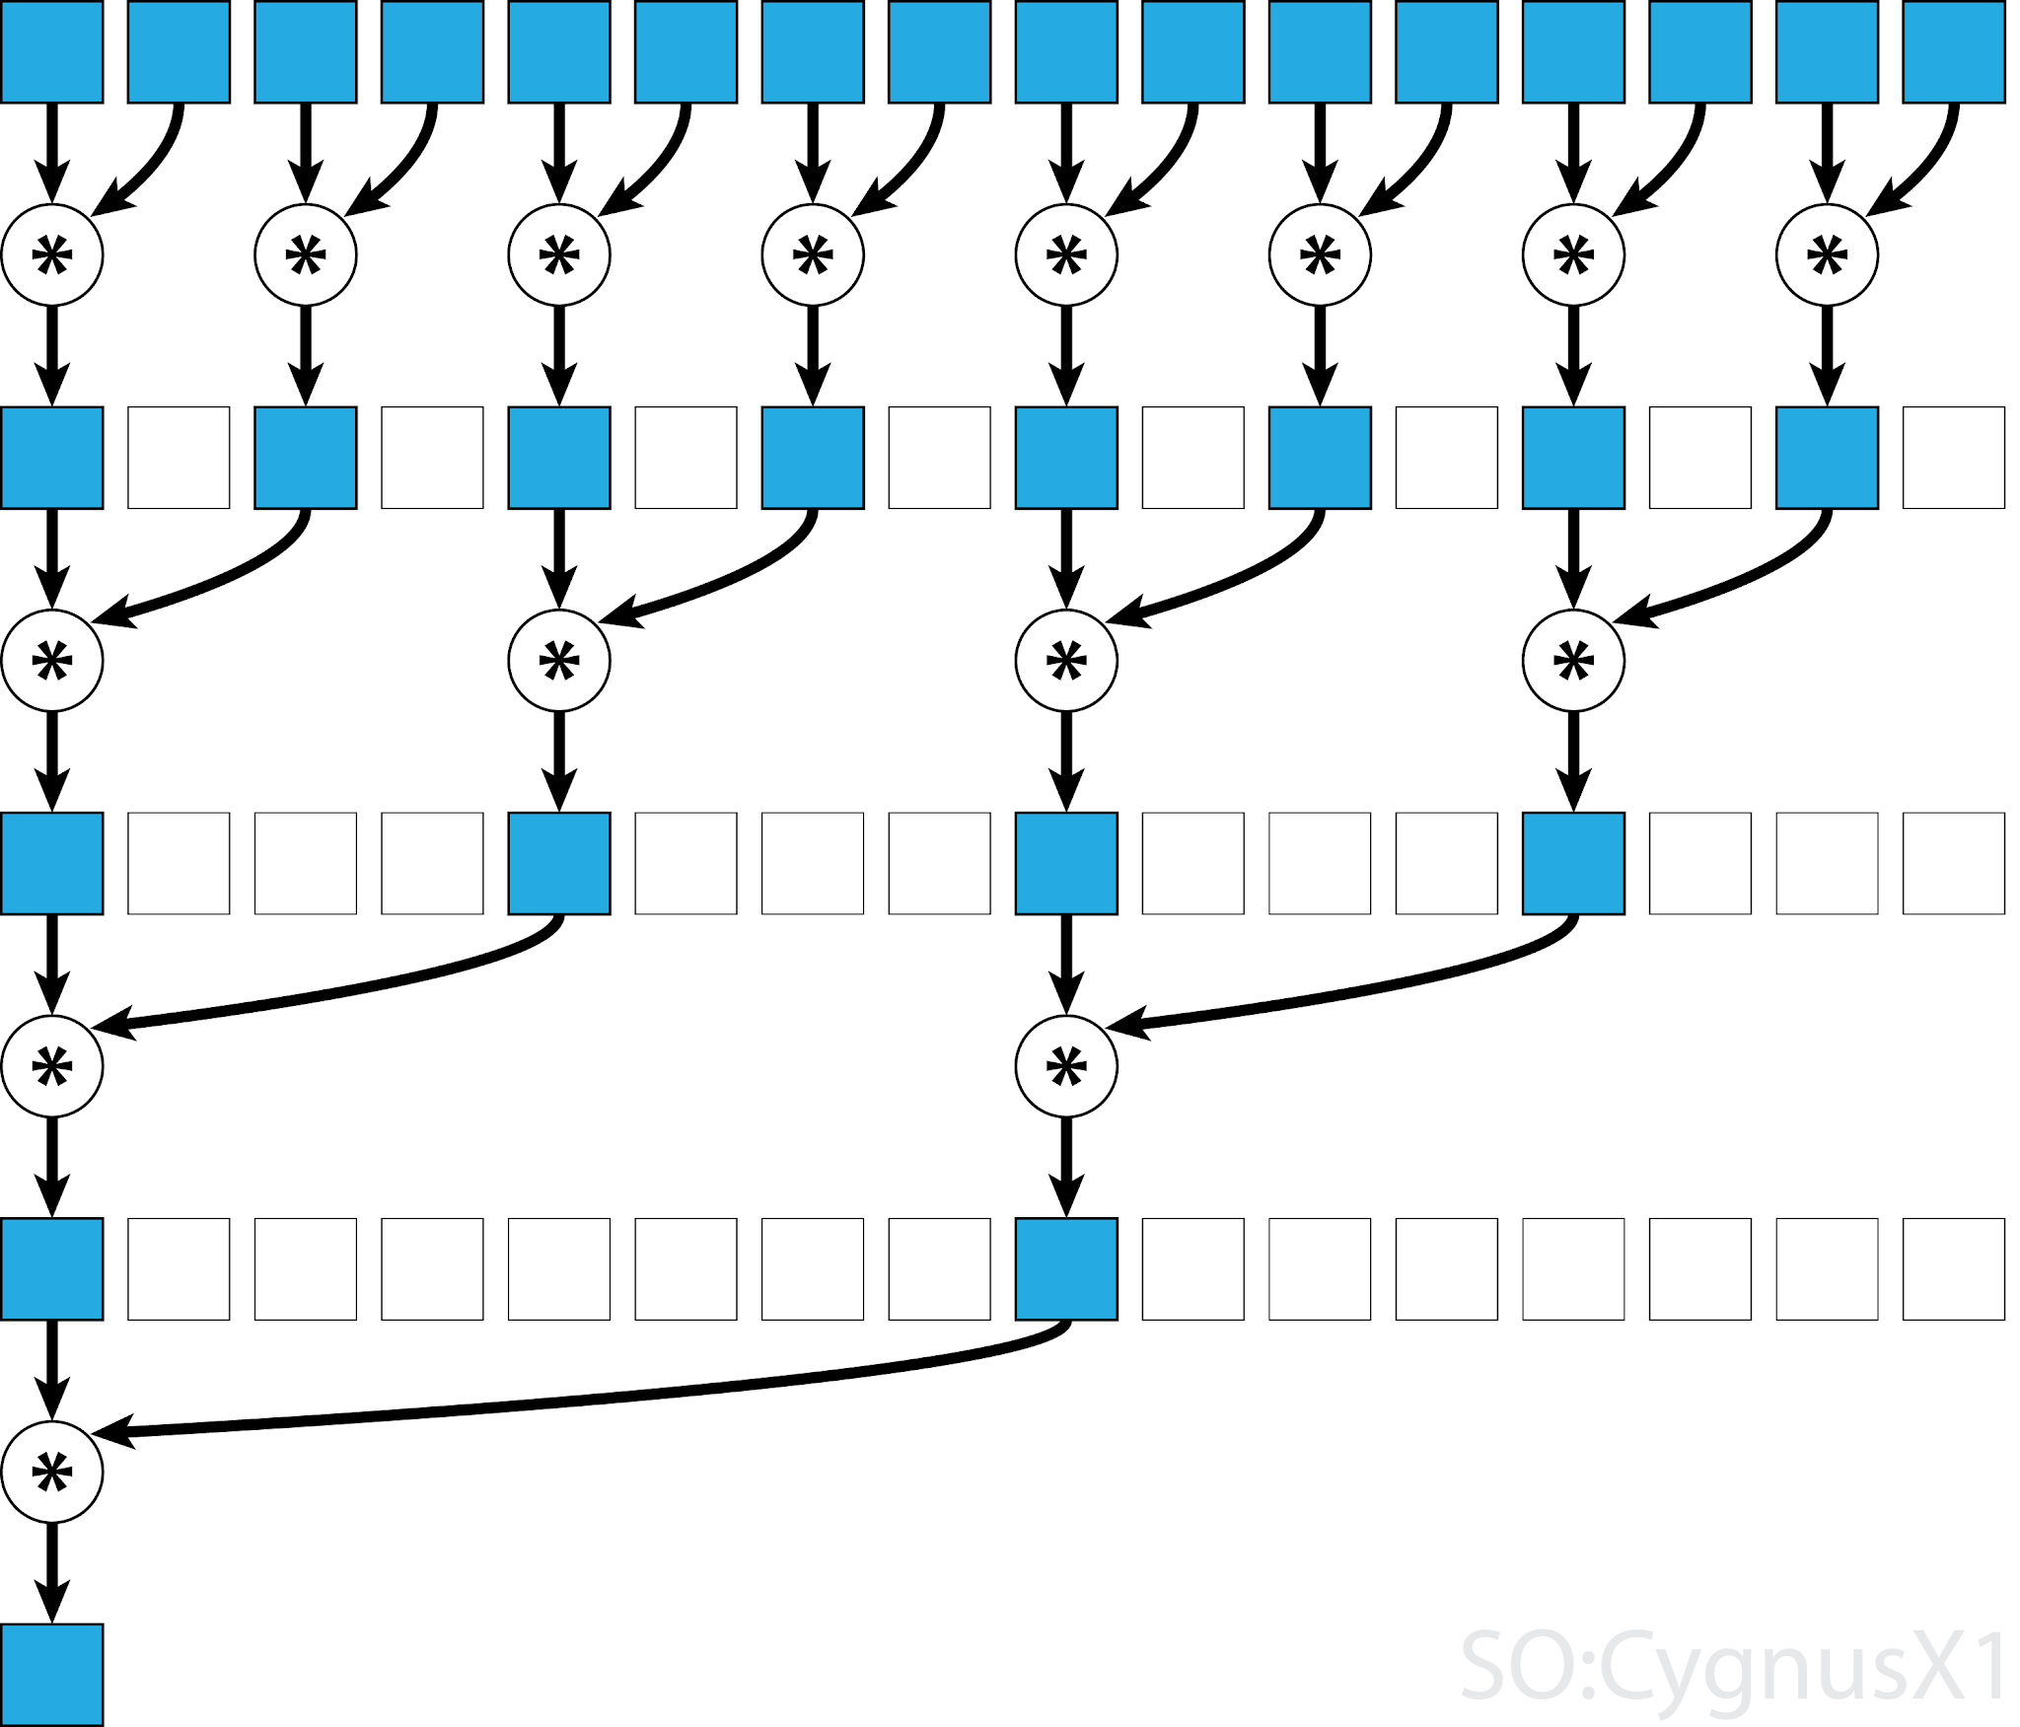
Lab 3: GPU Sum
vim sum_ans.cu
srun -G a100mig bash -c "/usr/local/cuda/bin/nvcc -arch native -o sum_ans sum_ans.cu; ./sum_ans"
Atomic add
all threads atomically add to a global variable
Atomic shared
threads add to block-shared variable
then finally to global variable
Reduce shared
Threads combine values in a block-shared array
Each step, half the threads from prev step are involved
One last atomic add at the end

Slide 61
Tutorial Summary
Understanding memory consistency models: faster performance at the cost of harder-to-achieve-correctness
Ideas behind optimizing CUDA programs
Profiling first
Then testing optimizations
Getting shared memory / constant memory / #registers from nvcc
CUDA Occupancy Calculator

Slide 62
End of Tut 3
Slides are uploaded here after every session GDrive: drive.zhiheng.dev
Anonymous Feedback: feedback.zhiheng.dev
Attendance

